Slide 1

Gas Production Prediction
Maryam Esmali
2/14/2021

Slide 2
List of Slides
Business Problem
Exploratory Data Analysis
Data Cleaning
Predictive Modeling
Conclusion

Slide 3
Business Problem
Production prediction is one of the core problems in our business. The provided dataset is a set of nearby wells located in the United States and their 12 months cumulative production. As a data scientist you want to build a model from scratch to predict production and show your manager that your model can perform well on unseen data.

Slide 4
Exploratory Data Analysis
Data frame’s shape
(1000, 28)
Highest Null Values
Breakdown Pressure 57%
Water Saturation 74%
Data types
String, Float, int

Slide 5
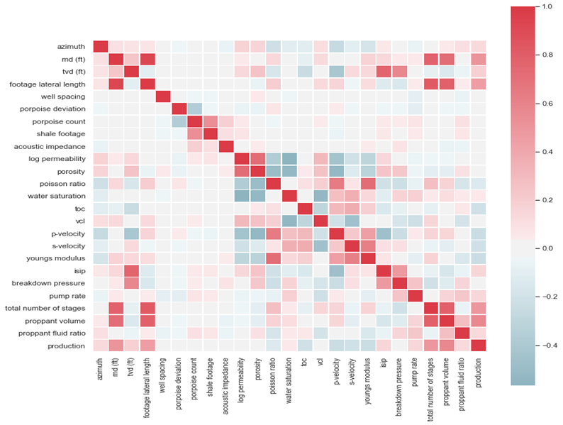
Understanding features Correlation with heat Map

Slide 6
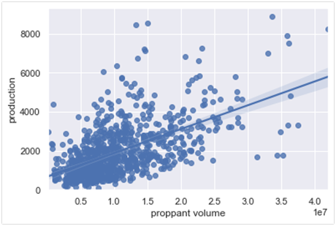
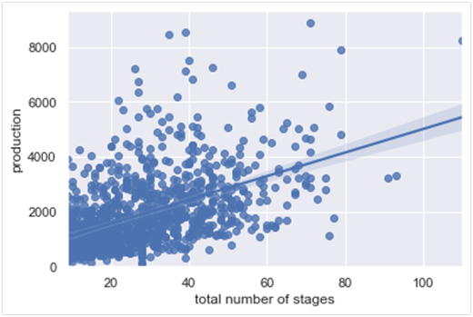
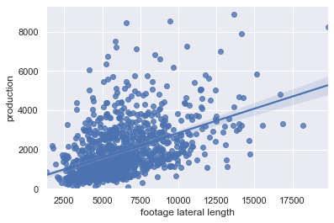
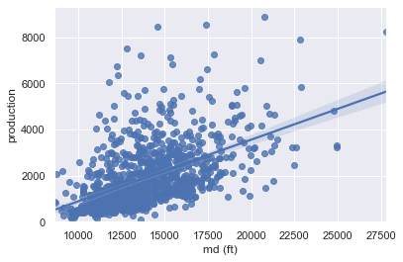
Highest Correlated Features With Gas Production
Proppant Volume vs. Production (0.57)
Total number of stages VS. PRODUCTION​ (0.49)
​
Footage lateral length VS. PRODUCTION(0.46)​
​
Measure depth VS. PRODUCTION(0.51)​
​

Slide 7
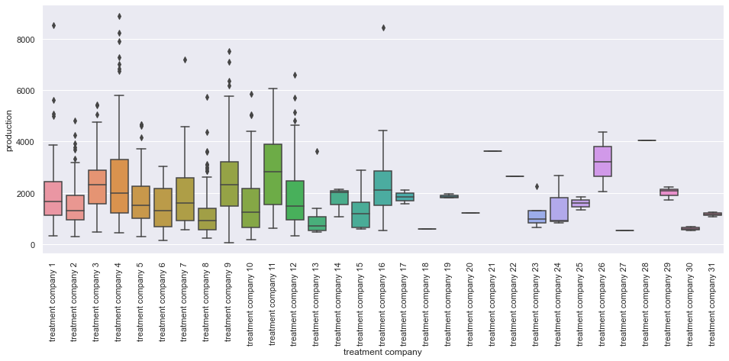
Treatment company and gas production

Slide 8
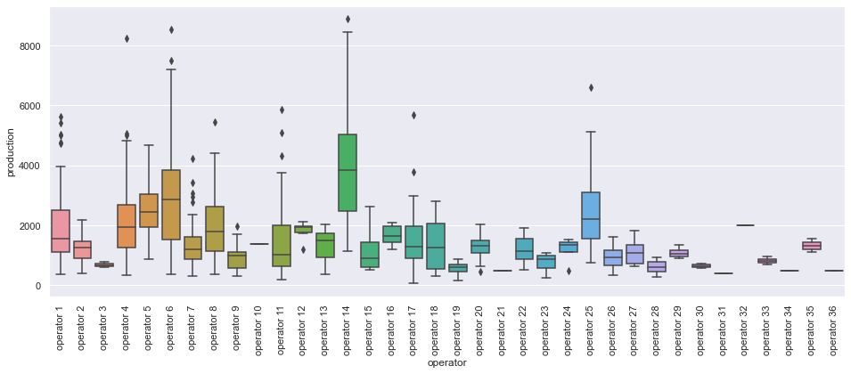
Operators and gas production

Slide 9
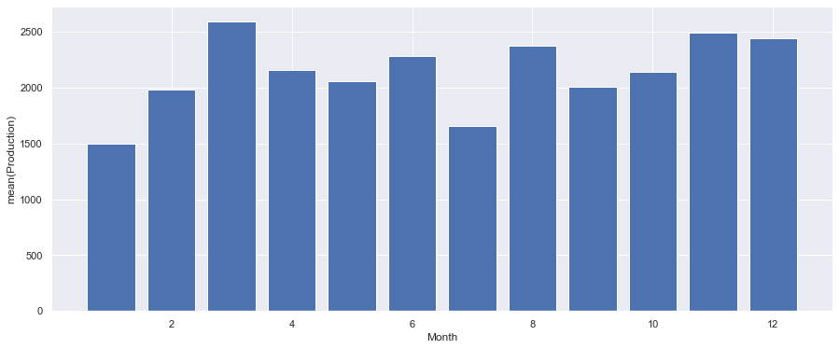
Monthly mean gas production

Slide 10
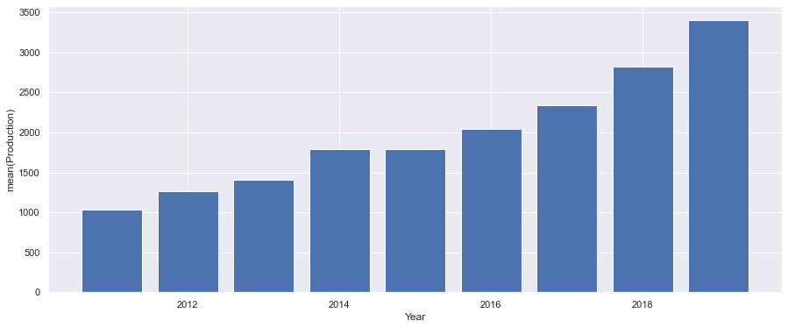
annual mean gas production

Slide 11
Cleaning DataSet
Handle missing data
Dropping columns with more than 30% null values
Imputing columns with less than 30% null values
One hot encoding for categorical data
Grouping values with less frequency as "other"

Slide 12
Regression models used
Linear Regression
SGDRegressor
Bayesian Regression
Ridge Regression
Gradient Boosting Regression

Slide 13
Regression model inputs and output
X | Y
'azimuth' 'md (ft)‘ 'tvd (ft)' 'footage lateral length' 'well spacing' 'porpoise deviation' 'acoustic impedance' 'log permeability' 'porosity' 'poisson ratio' 'toc' 'vcl' 's-velocity' 'youngs modulus' 'isip' 'pump rate' 'total number of stages', 'proppant volume', 'proppant fluid ratio' | 'production'

Slide 14
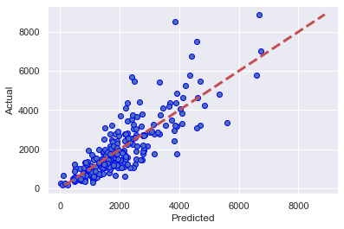
Linear Regression
MAE​​ | MSE​​ | R^2​​
​​579.955 | ​​699675.220 | ​​0.681

Slide 15

SGD Regressor
MAE​​ | MSE​​ | R^2​​
​​580.244 | ​​698770.751 | ​​0.681

Slide 16

Bayesian Regression
MAE​​ | MSE​​ | R^2​​
​​583.233 | ​​709838.005 | ​​0.676

Slide 17

Ridge Regression
MAE​​ | MSE​​ | R^2​​
​​580.017 | ​​699836.011 | ​​0.681

Slide 18
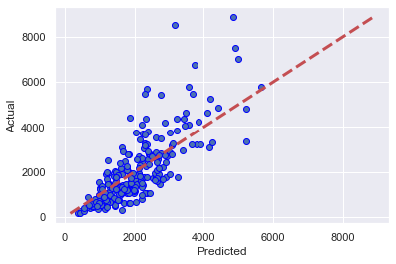
Gradient Boosting Regression
MAE​​ | MSE​​ | R^2​​
​​657.399 | ​​873383.564 | ​​0.601

Slide 19
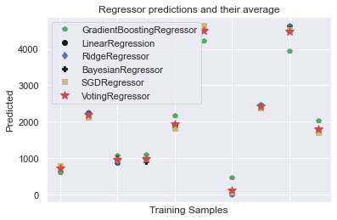
Voting Classifier
Ensamble for all regression models
MAE​​ | MSE​​ | R^2​​
​​560.950 | ​​665513.4739 | ​​0.601

Slide 20
Conclusion
Low frequency categories were combined to one category.
Features with more than 30 % missing values were dropped.
Correlations of features and target variable gave hints on good and bad candidates for model training.
Categorical values were transformed to numerical values using one hot encoding.
Effectiveness of different regression algorithms were compared.

